Slide 1

Career Framework Promotion
Panel Presentation Template
Name :
Current Family/Stream and Level :
New Career Family/Stream (if appropriate):
Next Career Level :
Date :

Slide 2
How to prepare for your Promotion Presentation (1)
  Using this slide template starting from slide 4 “About Me”, please complete each section as described below.
  The promotion panel will be keen to hear about the following:
    Your experience and achievements against the ‘next’ level in your Career Family/Stream
    Your progress to-date against your FY2026 objectives
    Evidence of how you live the CGI values – see next slide
    Your career goals and ambitions including your leadership potential
    Candidates going to Career Level 2 and 3 don’t need to do the Best Practice or Business Idea slide.
    For candidates going to Career Level 4 and upwards ONLY:
    Either:
    examples of best practice you have used or implemented which could be shared in other areas of the organisation
    Or
    a business idea – which could include innovation/IP, sharing best practice or process improvement
  This is an opportunity to practise and demonstrate your presentation skills and your ability to create impact and build rapport. See below the time guidelines for your presentation.
  Refer to the promotion readiness recording for more guidance.
  .
Slide presentation (Career Levels 2 and 3) | 10 minutes (+5 mins “grace” period)
Slide presentation (Career Levels 4+) | 15 minutes
Questions and answer | 15-25 minutes (may vary)

Slide 3
How to prepare for your Promotion Presentation (2)
Our CGI Values are fundamental to the way we work, so you are encouraged to reference these throughout your presentation, as appropriate. Below are some examples where you might show you’ve demonstrated the Values.
Slide | Value | Examples
About me | Corporate Social Responsibility | Supporting youth group or charities
 | Respect | Working with disadvantaged neighbours in your community.
My network | Partnership and Quality | Working with suppliers, partners and clients
 | Financial Strength | Understanding the financial constraints and impacts on suppliers, partners and clients
 | Corporate Social Responsibility | Working with client teams on Corporate Social Responsibility projects
My key achievements / My objectives | Corporate Social Responsibility | How your engagement contributes to our society (public safety, water, defence etc etc)
 | Financial Strength | On time, quality and budget delivery
 | Objectivity and Integrity | Working together in challenging times
 | Respect | When dealing with performance issues
 | Intrapreneurship and Sharing | Improvement ideas you have implemented, examples of sharing your knowledge with others

Slide 4
About me...
Use this slide to help the promotion panel know more about you – you can be creative and use graphics and photos to explain your narrative.
The panel will want to know a little bit more about you so that they can see what transferable skills you may have that you could incorporate into your role.
For example:
You may lead/coach a group outside of work that provide you with the skills to further leadership in the workplace, perhaps include a photo.
You might do something outside of work that would fulfil your Corporate Social Responsibility (CSR) objective.
What else are we looking for?
What projects have you worked on over the last year or two, providing a high-level overview, which will give the promotion panel an insight into your career journey to date.
What motivates you? This will help the promotion panel understand what you enjoy about your job, and when you get to the section about future ambitions, they will have an understanding of what motivates you so they can suggest relevant support. This is a short answer about motivation.
What expertise do you have that you feel sets you apart from others (Technical or soft skills are relevant). Again, a short answer please – more detail can be provided under achievements later on.

Slide 5
My network
The promotion panel want to be able to understand your role in your current assignment, to establish your level of responsibility, leadership and accountability.
To whom do you report/who reports to you?
Your key responsibilities and deliverables
Your key client interactions
The promotion panel are looking for evidence that you meet the criteria against the Generic Level Description and the Career Level Definition (CLD). Your response on this slide will provide certain aspects of that.
For Project/Service/Programme Managers, please include:
Size of project in financial terms – revenue, margin etc
Team profile – CGI, client, partner, supplier
Any specific features/challenges
Other related projects/programmes/services
If you wish, you can provide an organisation chart of your current network, incorporating any client, sector, BU, SBU interaction. This could include project connections, DE&I Networks, Career Family Communities, professional or client networks, Corporate Social Responsibility (CSR) connections.

Slide 6
My key achievements
Use this slide to tell us about your key achievements, focussing on the last year or so and how these demonstrate your capability at the next Career Level.
This is an opportunity for you to provide your evidence that you meet the criteria of Generic Level Description (GLD) and the Career Level Description (CLD) .
Please use the Career Level Definition for the ‘next’ level as your starting point.
Compare your capability against the criteria in the CLD and GLD..
You must meet at least 80% of the criteria to be able to be nominated, and it is sensible to know your plan of how you intend to fill any gaps in that remaining 20% in case you are asked in the QA session at the end of the panel.
We encourage you to structure this around the three CGI stakeholders, this will highlight your ability to balance the needs of the 3 stakeholders
Clients
CGI Partners
Shareholders
We’re keen to hear about specific examples and achievements,
focus on some key aspects.
You could use the STAR technique shown here:
This will help the panel gather the evidence they need to ensure you meet the criteria in the CLD and GLD that are applicable to your desired level in the career framework.
What has been the impact of these achievements:
For you ? And for CGI?
S | Situation | Detail the background. Provide a context, Where? When?
T | Task | Describe the challenge and expectations. What needed to be done? Why?
A | Action | Elaborate YOUR specific action. What did you do? How? What tools did you use?
R | Results | Explain the results: accomplishments, recognition. Quantify results if possible.

Slide 7
My FY2026 objectives
Please summarise your key objectives for the current year (as they appear in Progressio).
This is another opportunity to provide your evidence that you meet the criteria of the CLD and Generic Level Description.
When we talk about “key” objectives we mean the objectives that are specific to your project and you.
Not the generic task objectives that may have filtered down, like billable utilisation targets.
Pick two or three objectives to focus on as presentation time is limited.
You should have some stretch objectives, ones that show you have extended your capabilities and evidence your abilities and experience at the next Career Level. These should have enabled you to meet the criteria of the Generic Level Description and CLD because you have been working at the next Career Level for the past 6-12 months.
You may wish to include feedback/comments from your clients, Leader, project manager, colleagues on the slide, the promotion panel will read this for themselves when they receive your presentation deck ahead of your promotion panel – so please do not read that feedback out – you have limited time so don’t miss out on the opportunity to provide as much narrative as you can. Don’t waste time telling the promotion panel what they can read!

Slide 8

My plans and ambition for the future
Use this slide to tell the promotion panel:
about your career goals and how your plan to achieve them
  short term (1-to-2-year plan approximately)
  longer term (3-to-5-year plan approximately)
the support and development you need from CGI
The promotion panel want to know this so they can understand what CGI can do to support you whilst meeting the needs of the business, and how we (your BU, your Director/Line Manager, your engagement and you) can work together to maximise your potential.
You will have submitted your personal development plan (PDP) in advance of the promotion panel, so this is your opportunity to explain how this will help achieve your ambition/goals. Be specific – what support do you need, what opportunities do you need, taking into consideration the 70/20/10 model of learning that we utilise.
The promotion panel will also want to hear about your leadership skills and potential – remember you don’t have to have a team to be a leader. You could naturally lead the team you are in by providing support to new joiners, Early Careers Partners, knowledge sharing or supporting your colleagues.

Slide 9
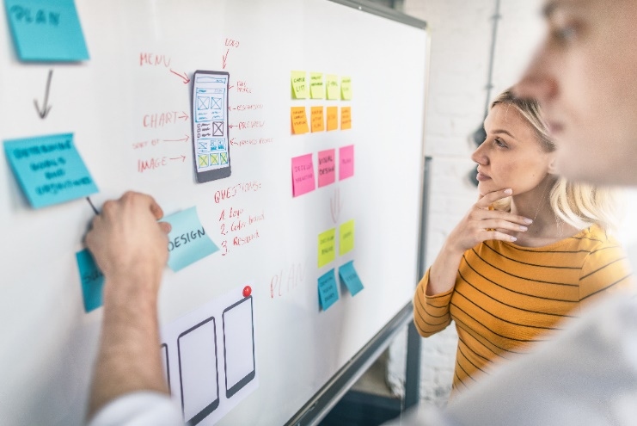
Building the business
ONLY use this slide if you are seeking promotion
to Career Level 4 and above. If you are seeking
promotion to Career level 2 or 3, you do not need
to do this slide.
Use this slide to
share an example of best practice
OR
present an idea for business improvement
Be as creative as you like…
But remember:
  You don’t have a lot of time ….
  The promotion panel will be looking for realistic and feasible ideas that will help our CGI Partners and our business.
  The promotion panel will be looking for an explanation of the idea and what next steps you would suggest.
  If you have a sponsor in mind to take your building the business idea forward, please brief them so we can move forward quickly, if it is decided to implement your idea.

